Slide 1
PC842 M.Tech Minor Project
Designing an Efficient Fog Computing System with Heterogeneous Nodes
PRESENTED BY:
Abhay Manavadariya (202311032)
M.Tech (ICT)
GUIDED BY:
Prof. Rahul Mishra
Prof. Tapas Kumar Maiti

Slide 2
Outlines
Introduction
Cloud Computing Limitations
Motivation
Key problem
Fog Computing
Architecture
Result
Conclusion
Future Work
References

Slide 3
Introduction
Increasing the demand of Internet of Things (IoT) devices and other smart devices.
According to IDC (International Data Corporation) , the Internet of Things (IoT) devices are increase 10.6% over 2022.
Limited computations and storage
Introduce the cloud computing

Slide 4
Cloud Computing Limitations
Dependence on Internet Connectivity
Security Concerns
Performance and Latency Issues
Bandwidth
Cascading Effect

Slide 5
Key Problem
Cloud computing often experiences inconsistent latency due to the physical distance between data centers and end-users, leading to delays in service delivery, particularly for real-time applications.
Many network applications require quick response times that centralized cloud servers cannot always provide.
Delayed responses can be critical in applications like autonomous driving, industrial automation, and real-time analytics.
Transmitting large amounts of data to centralized cloud servers consumes significant bandwidth, increasing operational costs and potentially causing network congestion.

Slide 6
Motivation
Empowering Edge Devices
Optimizing Resource Utilization
Enabling Real-Time Insights
Enhancing Data Security and Privacy

Slide 7
Fog Computing
Fog computing extends cloud computing.
Fog computing is the decentralized computing technology near to the edge devices.
focuses on optimizing user request and response efficiency.
This lead to faster processing time and fewer resources consumed.

Slide 8
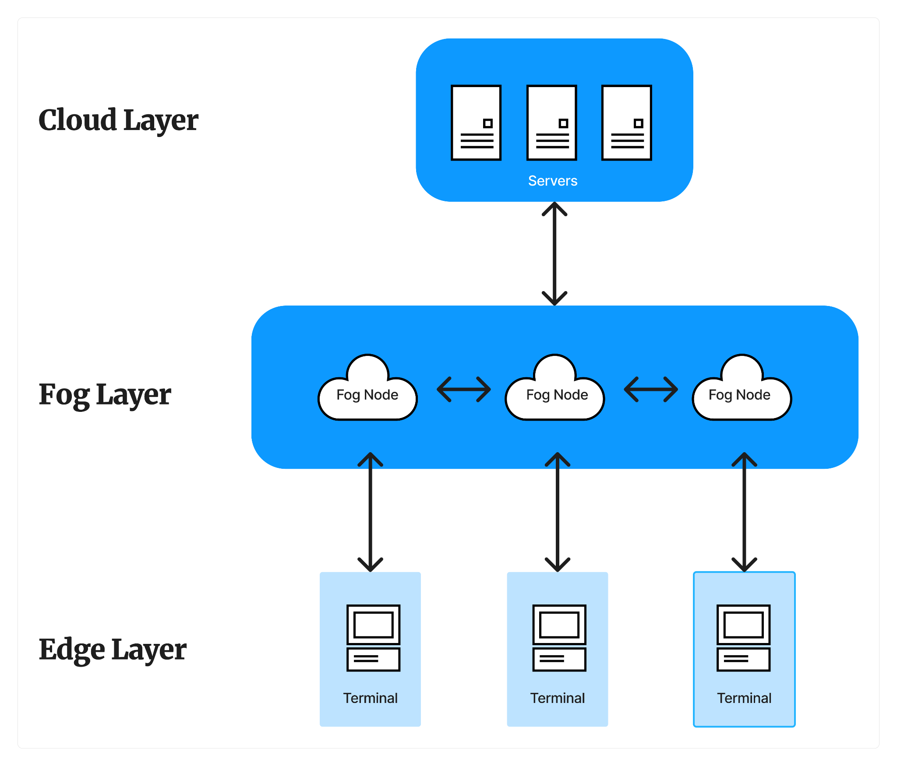
Fog Computing Architecture

Slide 9
Architecture
Client - Server Architecture
Single Client - Single Fog Architecture
Single Client - Multiple Fog Architecture
Multiple Client - Multiple Fog Architecture

Slide 10
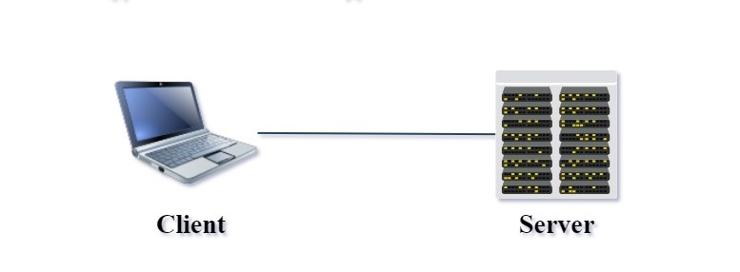
Client- Server Architecture

Slide 11
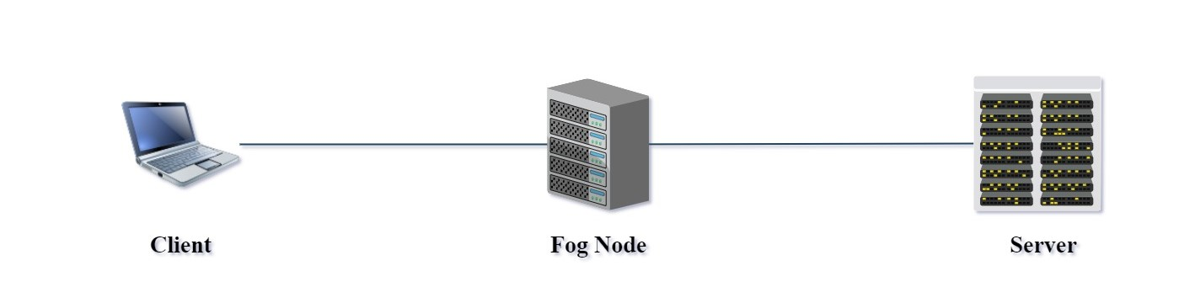
Single Client - Single Fog Architecture

Slide 12
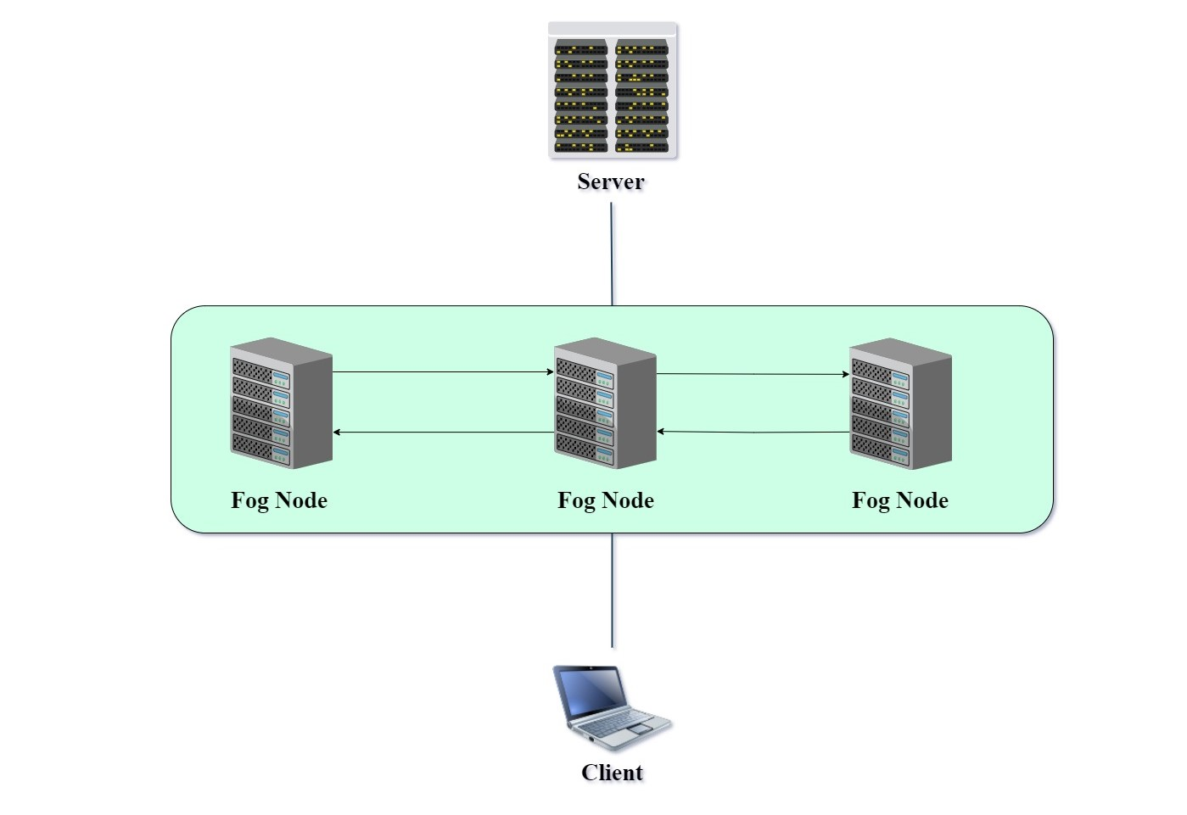
Single Client - Multiple Fog Architecture

Slide 13
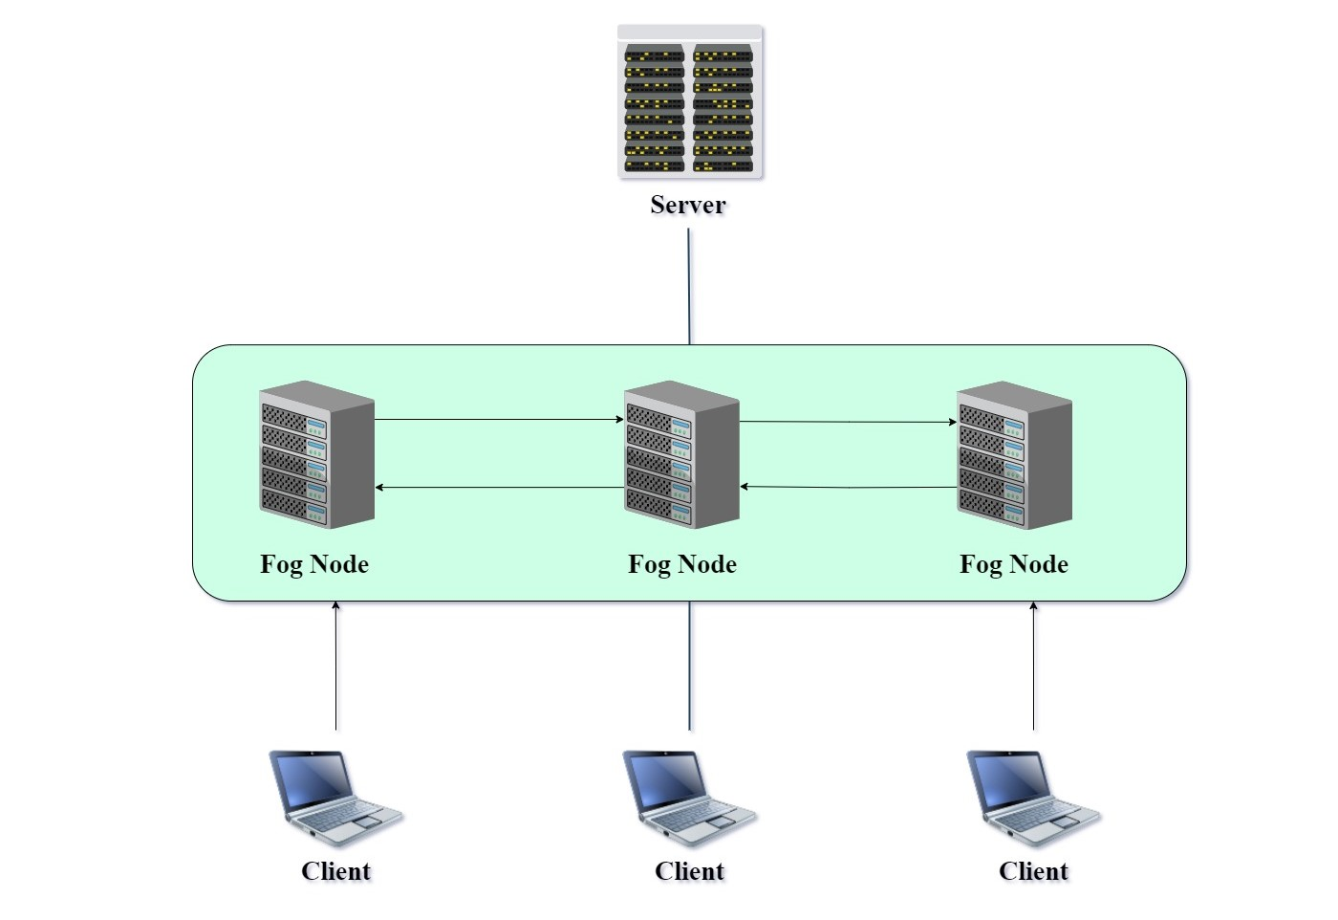
Multiple Client - Multiple Fog Architecture

Slide 14
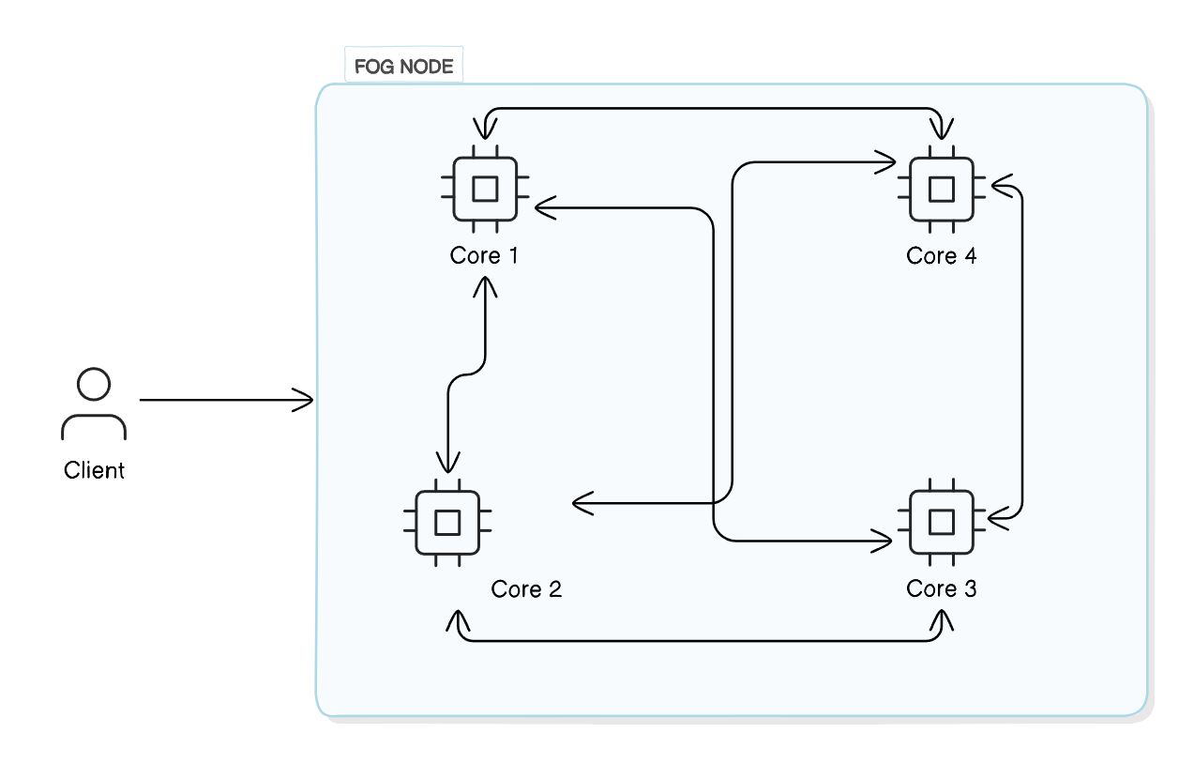
Fog with Core Architecture

Slide 15
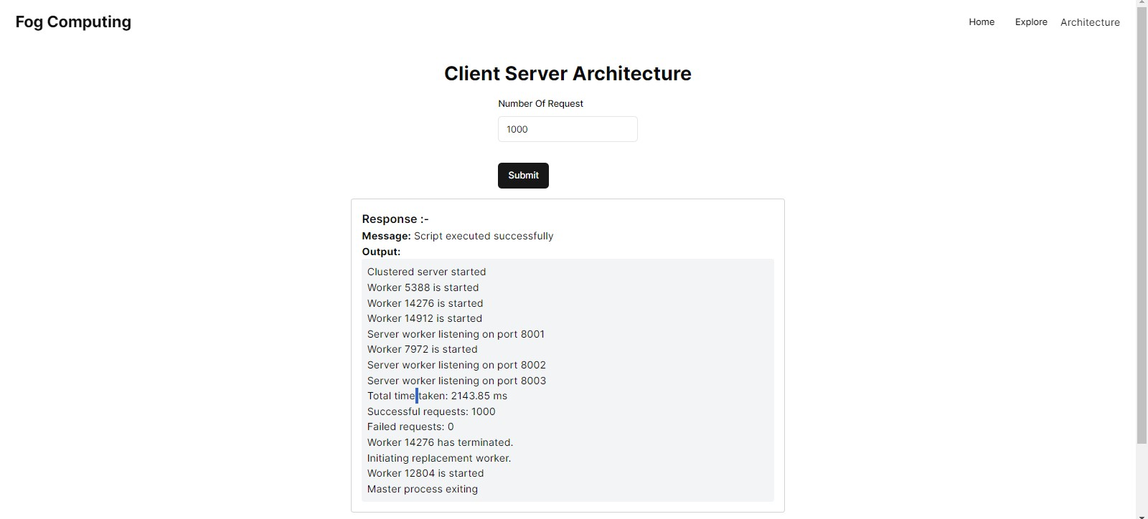
Result
Client Server Architecture, Total Request: 1000, Time: 2143.85ms

Slide 16
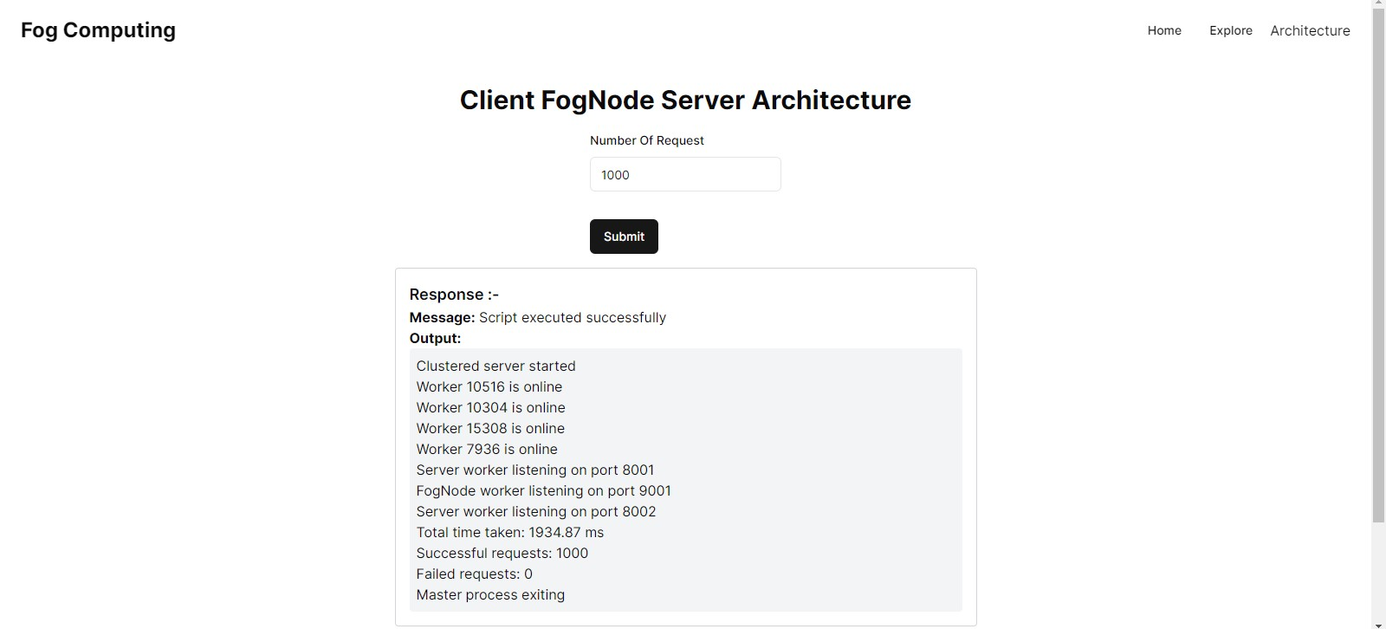
Cont…
Client Fog Architecture, Total Request: 1000, Time: 1934.87ms

Slide 17
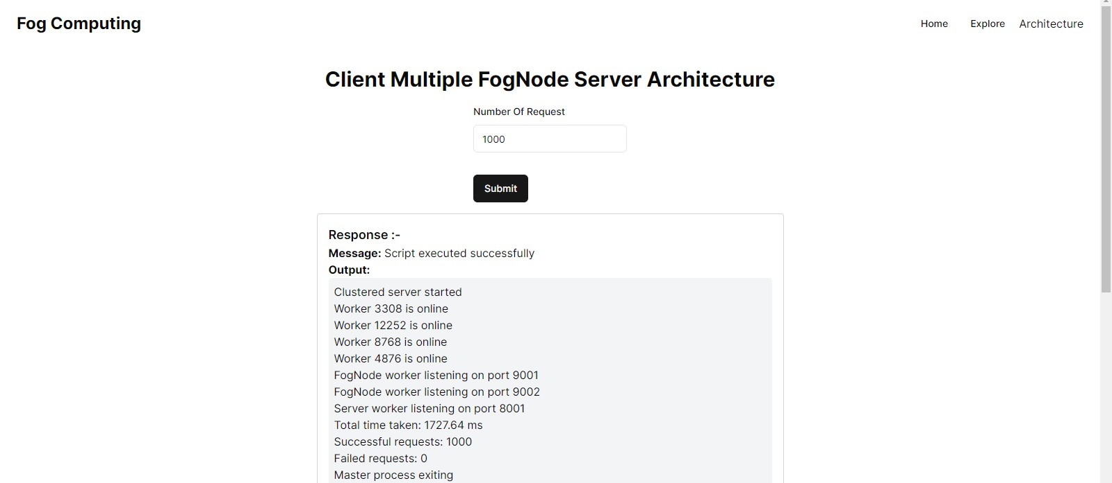
Cont…
Client Multiple Fog Architecture, Total Request: 1000, Time: 1727.64ms

Slide 18
Conclusion
Significance: The Fog Computing Project develops edge resources to improve the scalability and performance of distributed computing systems.
Foundation: Fog computing systems that are effective are built on a foundation of expanding fog nodes and optimizing task allocation.
Insights: Performance evaluations highlight improved system throughput and reduced latency.
Future Direction: Aim to advance fog computing systems to efficiently handle diverse workloads in dynamic edge environments.

Slide 19
Future Work
Enhance capabilities of fog computing systems
Develop dynamic task offloading algorithms considering heterogeneous fog nodes
Design algorithms optimizing task allocation based on system configurations like core count and processing power
Expanding the Fog Nodes Network

Slide 20
References
R. Mishra, H. P. Gupta, P. Kumari, D. Y. Suh and M. J. Piran, "A Task Offloading and Reallocation Scheme for Passenger Assistance Using Fog Computing," in IEEE Transactions on Network and Service Management, vol. 19, no. 3, pp. 3032-3047, Sept. 2022, doi: 10.1109/TNSM.2022.3172602. [1]
PictureShanhe Yi, PictureCheng Li, PictureQun Li "A Survey of Fog Computing: Concepts, Applications and Issues" https://doi.org/10.1145/2757384.2757397. [2]
https://blogs.cisco.com/perspectives/iot-from-cloud-to-fog-computing. [3]
Gil Press. IDC: Top 10 technology predictions for 2015. http://goo.gl/zFujnE, 2014. [4]

Slide 21
Thank You !

